Slide 1
Research Methodology- Unit 3 Chapter 1- Concept of Research Design
Prime College- BIM 6th Semester

Slide 2
What is Research Design?
Research design is the framework of research methods and techniques chosen by a researcher to conduct a study. The design allows researchers to sharpen the research methods suitable for the subject matter and set up their studies for success.
Creating a research topic explains the type of research (experimental, survey research, correlational, semi-experimental, review) and its sub-type (experimental design, research problem, descriptive case-study).
Types of Research:
Qualitative Research
Quantitative Research

Slide 3

What is the Difference between Qualitative and Quantitative

Slide 4
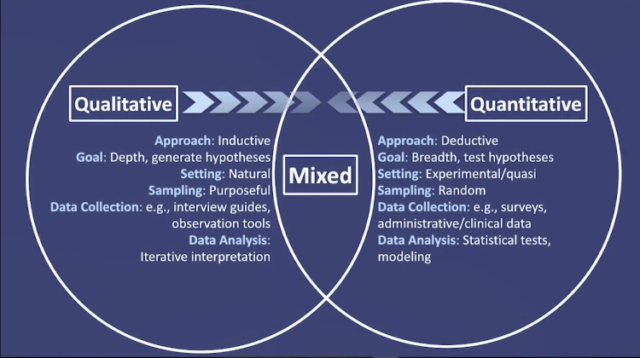

Slide 5
Creswell (2018)

Slide 6
Qualitative vs Quantitative Research
 | Qualitative | Quantitative
Focus of Research | Understand and interpret | Describe, explain, and predict
Researcher Involvement | High | Limited, controlled to prevent bias
Research Purpose | In-depth understanding | Describe or predict, built and test theory
Sample Design | Non-probability, purposive | Probability
Sample Size | Small | Large
Data Type and Preparation | Verbal or pictorial description Reduced to verbal codes | Reduced to numerical codes for computerized analysis
Feedback Turnaround | Smaller sample sizes make data collection faster | Larger sample sizes lengthen data collection
Research Design | Longitudinal, Multi Method | Cross-sectional or longitudinal, Single method
Data Analysis | Non-quantitative; human Judgment mixed with fact Emphasis on themes | Computerized analysis Facts distinguished Emphasis on counts

Slide 7

What is Qualitative Research

Slide 8

Definition of Qualitative : Creswell 2018
Qualitative research is an approach for exploring and understanding the meaning individuals or groups ascribe to a social or human problem.
The process of research involves:
Emerging questions and procedures,
Data typically collected in the participant’s setting
Data analysis inductively building from particulars to general themes, and the researcher making interpretations of the meaning of the data.
Example: Explore the Lived experience of retirees.
An exploratory study of why successful career women
drop out to stay at home

Slide 9
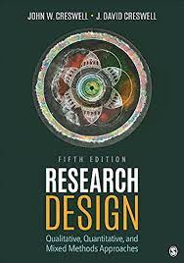
What is Qualitative Research
(adapted from Creswell 2002, p. 58)
Subjective
Qualitative research is an inquiry approach in which the inquirer:
Explores a central phenomenon (one key concept)
Asks participants broad, general questions
Collects detailed views of participants in the form of words or images
Analyses and codes the data for description and themes
Interprets the meaning of the Information drawing on personal reflections and past research
Writes a Final Report

Slide 10
Definition Creswell & Poth, 2017
Qualitative research begins with assumptions and the use of interpretive/theoretical frameworks that inform the study of research problems addressing the meaning individuals or groups ascribe to a social or human problem.
To study this problem, qualitative researchers use an emerging qualitative approach to inquiry, the collection of data in a natural setting sensitive to the people and places under study, and data analysis that is both inductive and deductive and establishes patterns or themes.
The final written report or presentation includes the voices of participants, the reflexivity of the researcher, a complex description and interpretation of the problem, and its contribution to the literature or a call for change. (Creswell, 2013, p. 44)

Slide 11
Definition Sharan B. Merriam, Elizabeth J. Tisdel
Qualitative research is based on the belief that knowledge is constructed by people in an ongoing fashion as they engage in and make meaning of an activity, experience, or phenomenon
Understanding how people interpret their experiences, how they construct their worlds, and what meaning they attribute to their experiences.
Example:
Rather than finding out how many retired folks take on part - time jobs after retirement, which could be done through a survey, we might be more interested in how people adjust to retirement, how they think about this phase of their lives, the process they engaged in when moving from full - time work to retirement, and so on

Slide 12

What are the stages in a Qualitative Research

Slide 13
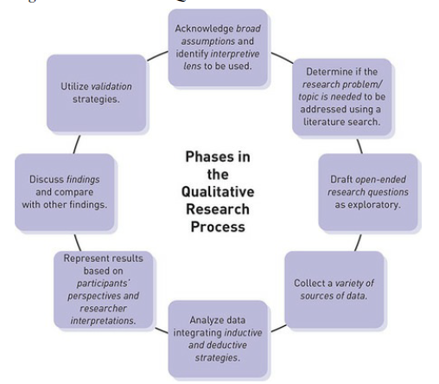
Qualitative Research Process – Creswell & Poth, 2017
Written Record
(Thesis, book, report, article etc)
Data Analysis Approach
(Hermeneutics, semiotics, content analysis etc)
Data Collection Technique
(interviews, focus group, observation, documents etc)
Research Method
(action research, case study, ethnography, grounded theory etc)
Philosophical Assumptions
(positivist, interpretive, pragmatic)

Slide 14
Five features distinguish qualitative research
Studying the meaning of people’s lives, in their real-world roles;
Eg: Live of homeless women in America
2. Representing the views and perspectives of the people (labeled as the participants) in a study (not views of researcher)
3. Explicitly attending to and accounting for real-world contextual conditions;
That is, the social, institutional, cultural, and environmental conditions—within which people’s lives take place
4. Contributing insights from existing or new concepts that may help to explain social behavior and thinking;
Qualitative research is driven by a desire to explain social behavior and thinking, through existing or emerging concepts
5. Acknowledging the potential relevance of multiple sources of evidence rather than relying on a single source alone.

Slide 15

Grounded Theory
Glaser and Strauss (1967) developed a pioneering book that expounded in detail on their grounded theory procedures, The Discovery of Grounded Theory.
Grounded theory is a design of inquiry from sociology in which the researcher derives a general, abstract theory of a process, action, or interaction grounded in the views of participants (grounded in data).
This process involves using multiple stages of data collection and the refinement and interrelationship of categories of information (Charmaz, 2006; Corbin & Strauss, 2007).
Notes:
https://www.youtube.com/watch?v=tirZ7ktPW64

Slide 16
Grounded Theory
The purpose of grounded theory research in education and management is to develop new concepts and theories of education/management related phenomena, where these concepts and theories are firmly grounded in qualitative data

Slide 17
Grounded Theory
Creswell (2009), “a qualitative strategy of inquiry in which the researcher derives a general, abstract theory of process, action, or interaction grounded in the views of participants in a study.” (p. 13 & 229)
This process involves using multiple stages of data collection and the refinement and interrelationships of categories of information (Charmaz, 2006; Strauss and Corbin, 1990, 1998).
Iteration and Constant Comparison

Slide 18
Grounded Theory
A grounded theory design is a systematic, qualitative procedure used to generate a theory that explains, at a broad conceptual level, a process, an action, or an interaction about a substantive topic (Creswell, 2008).
The approach is systematic and is used to develop a theory that explains a process, action, or interaction.
• The participants are chosen by theoretical sampling to help the researchers form the best theories
• The data is collected mainly through 20- 30 interviews during multiple visits to the field to saturate categories (happenings, events, documents)

Slide 19
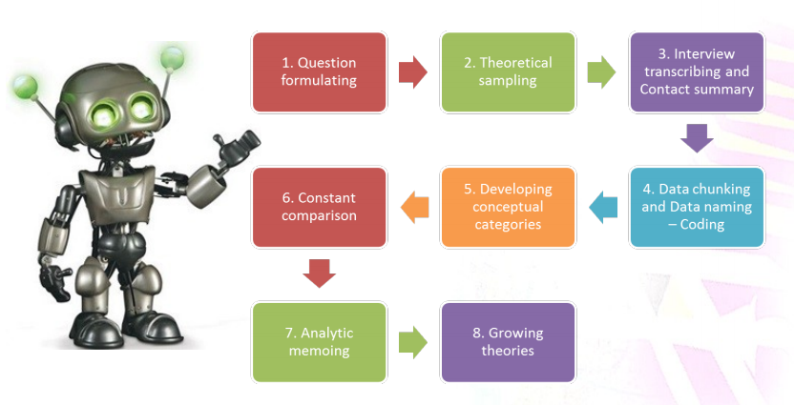
How to do a Grounded Theory

Slide 20
Grounded Theory Research Procedures: Strauss & Corbin (1990, 1998)
Focus research questions on understanding how individuals experience the process and identify the steps in the process
Conduct interviews with 20-30 participants
Questions focus on the steps in the process
Additional questions focus on what was central to the process, the causes of the phenomenon, the strategies employed during the process, and the effects or consequences that occurred
Data collection occurs until there is saturation

Slide 21
Example of Grounded Theory
“Victimising of School Bullying: a Grounded Theory” by Robert Thornberg, Karolina Halldin, Natalie Bolmsjö & Annelie Petersson
This study analyses the experiences and perceptions of victims of bullying in elementary schools in Sweden. The study’s initial goal was to “investigate how individuals, who had been victims of school bullying perceived their bullying experiences and how these had affected them, as well as to generate a grounded theory of being a victim of bullying at school” (Thornberg et al., 2011, p. 311).
For example, a company with a high attrition rate that has not done any research on this area before may choose grounded theory to understand key reasons why people choose to leave. Researchers may start looking at the quantitative data around departures over the year and look for patterns.

Slide 22
Participants
21 participants were in the final sample as volunteers who had been victims of elementary school bullying which lasted over the duration of one year. Of the 21 participants, 9 were from secondary schools, 12 were from the university. Their ages ranged was from ages 17 to 34.
Data Collection
Individual qualitative semi-structured interviews were conducted in a quiet room away from students and teachers in their schools.
Interviews followed a common interview guide, which asked participants to talk about:
“(a) their victimisation experiences of school bullying, from the very start to end,
(b) their thoughts, feelings and actions regarding the bullying they had experienced and
(c) their perceptions of how their bullying experiences had affected them during as well as after the bullying period”
The interviews were audio recorded and transcribed verbatim.

Slide 23
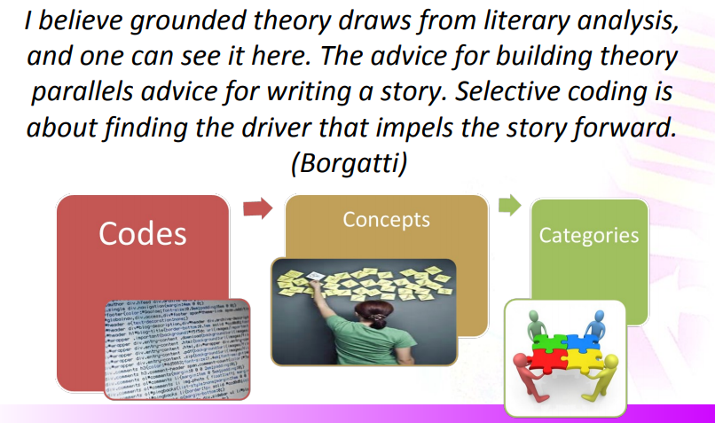
How to do data Analysis

Slide 24
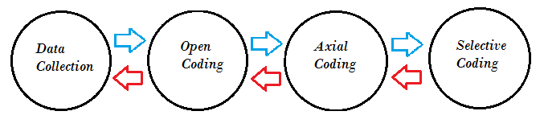
Grounded Theory Research Procedures: Strauss & Corbin (1990,1998)
Data collection proceeds in stages
Open coding – researcher forms categories of information about the phenomenon by segmenting the information into dimensionalized categories
Axial coding – categories are assembled into a visual model in which the researcher identifies a central phenomenon (category that describes what the process is), causes, strategies, contexts, intervening conditions, and consequences (outcomes)
Selective coding – a story line that connects the categories
The theory that results is a substantive-level theory that addresses a specific problem or people

Slide 25
Ethnography
Ethnography is a design of inquiry coming from anthropology and sociology in which the researcher studies the shared patterns of behaviors, language, and actions of an intact cultural group in a natural setting over a prolonged period of time.
Data collection often involves observations and interviews.

Slide 26
Ethnography
A description and interpretation of a cultural or social group or system.
The researcher examines the group’s observable patterns of behavior, customs, and ways of life.
Involves prolonged observation of the group, typically through participant observation.
Focus: study human behavior in the cultural context in which it is embedded
Example:
Study with the purpose of understanding a very isolated tribe in the Amazon basin

Slide 27

Case study

Slide 28
What is a Case Study
A case study is an in-depth inquiry into a topic or phenomenon within its real-life setting (Yin 2014).
“A case study is an empirical study that investigates a contemporary phenomenon in depth and with its real-life context” (Yin, 2009, p18)
Patton (1990) suggests that case studies are valuable in creating deep understanding of particular people, problems or situations in comprehensive ways.
Once defined, case study research sets out to understand the dynamics of the topic being studied within its setting or context
Saunders 2016

Slide 29
Creswell (2002) "an in-depth exploration of a bounded system (e.g., an activity, event, process, or individuals) based on extensive data collection" (p. 485).
Creswell recommends case study as a methodology if the problem to be studied "relates to developing an in-depth understanding of a 'case' or bounded system" (p. 496) and if the purpose is to understand "an event, activity, process, or one or more individuals" (p. 496).
Cases are bounded by time and activity, and researchers collect detailed information using a variety of data collection procedures over a sustained period of time (Stake, 1995; Yin, 2009, 2012).
Case Studies
Bounded
system
"'Bounded' means that the case is separated out for research in terms of time, place, or some physical boundaries" (Cresswell p. 485).
In other words, it is possible to create limits around the object to be studied (Merriam, 1998)

Slide 30
CASE STUDIES - Cases are units of investigation
Cases can be
Person/persons
Group/groups
Organization/organizations
Institution/institutions
Event/events.
Employee/group employees
Student/group of students
The ‘case’ in case study research may refer to a person (e.g. a manager), a group (e.g. a work team), an organisation (e.g. a business), an association (e.g. a joint venture), a change process (e.g. restructuring a company), an event (e.g. an annual general meeting) as well as many other types of case subject
A case study is an in-depth description and analysis of a bounded system.
A single entity, a unit around which there are boundaries.
An in-depth analysis of a case, often a program, event, activity, process, or one or more individuals.

Slide 31
Case study Collection of data
Three main methods used: Survey, field study, historical info
Direct observations (e.g., human actions or a physical environment)
Interviews (e.g., open-ended conversations with key participants)
Archival records (e.g., student records)
Documents (e.g., newspaper articles, letters and e-mails, reports)
Participant-observation (e.g., being identified as a researcher but also filling a real-life role in the scene being studied)
Physical artifacts (e.g., computer downloads of employees’ work)

Slide 32
Types of Case study
A case study is the study of an issue through one or more cases in a setting or context (a bounded system)
An exploration of a “bounded system” or a case (or multiple cases) over time through detailed, in-depth data collection involving multiple sources of information rich in context
Exploratory Case study – to explore certain subjects
Explanatory case study Based on theory
Descriptive – data explain descriptively a phenomenon
In-depth investigation of a single or small number of units at a point (over a period) in time. E.g. Evaluation of customer service

Slide 33
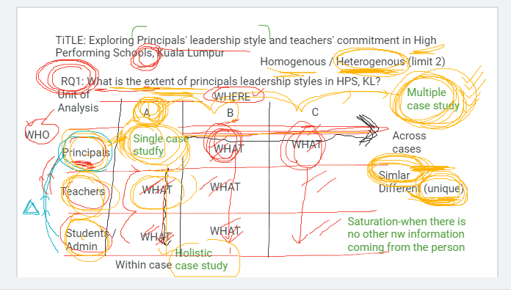
Title: Exploring Principals leadership style and teachers commitment in High Performing Schools in Kuala Lumpur
RQ1: What are the leadership styles in High performing schools?
WHO
Homogeneous or Heterogeneous
Units of Analysis | School A | School B | School C
Principals | What | What | What
Teachers | What | What | What
Students Admin | What | What
Data Triangulation
Holistic or Embedded (within the Case study)
Single Case Vs Multiple Case Study
(across cases)

Slide 34
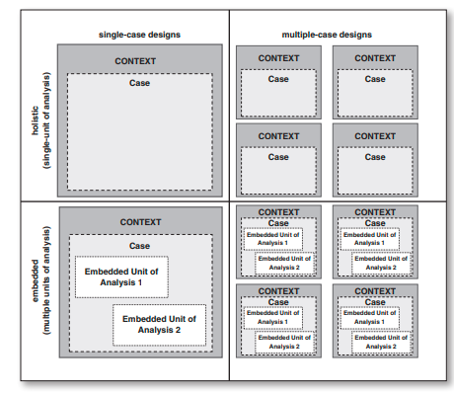
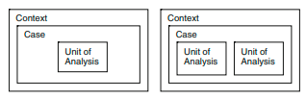
Types of Case Studies Designs
A single or multiple cases
Single case: allow for an in-depth understanding of the single phenomenon
Multiple: allows for a more in-depth understanding of the cases as a unit,
through comparison of similarities and differences
Holistic or embedded
Holistic case studies - where the case is studied as a whole,
Embedded case studies - where multiple units of analysis are studied within a case

Slide 35
Types of Case Studies
Intrinsic case study
Researcher wants to understand a particular case in-depth
Eg: A case of discipline in an institution
Instrumental case study –
Carried out to understand a theory or a theory related problem
Collect rich data related to a theory
Eg: Case study on implementation of transformational leadership style of a manager to increase performance
Collective or multiple instrumental case study
A combination of a number of instrumental case studies – in depth
Understand theory from a larger context
Eg: A collective case study to understand the reasons for the defeat of a political party. Research carried on a number of single cases (instrumental case studies)

Slide 36
Case Study Research Procedures
Identify the case or cases to be studied
What kind of case study is most appropriate
What case or cases will be studied
Select cases that show different perspectives through maximal variation sampling
Engage in multiple forms of data collection including interviews, observations, documents, audiovisual materials, observations to develop an in-depth understanding of the case(s)
Develop a detailed description of the case(s) and common themes in the cases
When using multiple cases describe each case and themes first (within-case analysis)
Compare cases to look for common themes (cross-case analysis)
Look for common assertions and meanings within the case
Report the lessons learned from the case regarding the issue of the case (instrumental) or learning about an unusual situation (intrinsic case)

Slide 37
Types of Quantitative Research Design
Descriptive research
Correlational research
Causal-comparative/quasi-experimental research
Experimental research

Slide 38
Types of Quantitative Research Design
Descriptive research
Descriptive research seeks to describe the current status of an identified variable.
These research projects are designed to provide systematic information about a phenomenon.
The researcher does not usually begin with an hypothesis, but is likely to develop one after collecting data.
The analysis and synthesis of the data provide the test of the hypothesis.
Systematic collection of information requires careful selection of the units studied and careful measurement of each variable.
Correlational research
Correlational research attempts to determine the extent of a relationship between two or more variables using statistical data. In this type of design, relationships between and among a number of facts are sought and interpreted.
This type of research will recognize trends and patterns in data, but it does not go so far in its analysis to prove causes for these observed patterns.
Cause and effect is not the basis of this type of observational research.
The data, relationships, and distributions of variables are studied only. Variables are not manipulated; they are only identified and are studied as they occur in a natural setting.
*Sometimes correlational research is considered a type of descriptive research, and not as its own type of research, as no variables are manipulated in the study.

Slide 39
Types of Quantitative Research Design
Examples of Descriptive Research:
• A description of how second-grade students spend their time during summer vacation
• A description of the tobacco use habits of teenagers
• A description of how parents feel about the twelvemonth school year
• A description of the attitudes of scientists regarding global warming
• A description of the kinds of physical activities that typically occur in nursing homes, and how frequently each occurs
• A description of the extent to which elementary teachers use math manipulative
Examples of Correlational Research:
• The relationship between intelligence and self-esteem
• The relationship between diet and anxiety
• The relationship between an aptitude test and success in an algebra course
• The relationship between ACT scores and the freshman grades • The relationships between the types of activities used in math classrooms and student achievement
• The covariance of smoking and lung disease

Slide 40
Types of Quantitative Research Design
Causal-comparative/quasiexperimental research
Causal-comparative/quasiexperimental research attempts to establish cause and effect relationships among the variables.
These types of design are very similar to true experiments, but with some key differences.
An independent variable is identified but not manipulated by the experimenter, and effects of the independent variable on the dependent variable are measured.
The researcher does not randomly assign groups and must use ones that are naturally formed or pre-existing groups. Identified control groups exposed to the treatment variable are studied and compared to groups who are not.
When analyses and conclusions are made, determining causes must be done carefully, as other variables, both known and unknown, could still affect the outcome. A causal comparative designed study, described in a New York Times article, "The Case for $320,00 Kindergarten Teachers," illustrates how causation must be thoroughly assessed before firm relationships amongst variables can be made.
Experimental research
Experimental research, often called true experimentation, uses the scientific method to establish the cause-effect relationship among a group of variables that make up a study.
The true experiment is often thought of as a laboratory study, but this is not always the case; a laboratory setting has nothing to do with it.
A true experiment is any study where an effort is made to identify and impose control over all other variables except one.
An independent variable is manipulated to determine the effects on the dependent variables.
Subjects are randomly assigned to experimental treatments rather than identified in naturally occurring groups

Slide 41
Types of Quantitative Research Design
Examples of Causal-comparative/quasiexperimental research
• The effect of preschool attendance on social maturity at the end of the first grade
• The effect of taking multivitamins on a students’ school absenteeism
• The effect of gender on algebra achievement
• The effect of part-time employment on the achievement of high school students
• The effect of magnet school participation on student attitude
• The effect of age on lung capacity
Examples of Experimental Research:
• The effect of a new treatment plan on breast cancer
• The effect of positive reinforcement on attitude toward school
• The effect of teaching with a cooperative group strategy or a traditional lecture approach on students’ achievement
• The effect of a systematic preparation and support system on children who were scheduled for surgery on the amount of psychological upset and cooperation
• A comparison of the effect of personalized instruction vs. traditional instruction on computational skill

Slide 42
End of Unit 3
(Click the arrow when in Slide Show mode)
Notes:
In Slide Show mode, click the arrow to enter the PowerPoint Getting Started Center.

